Slide 1
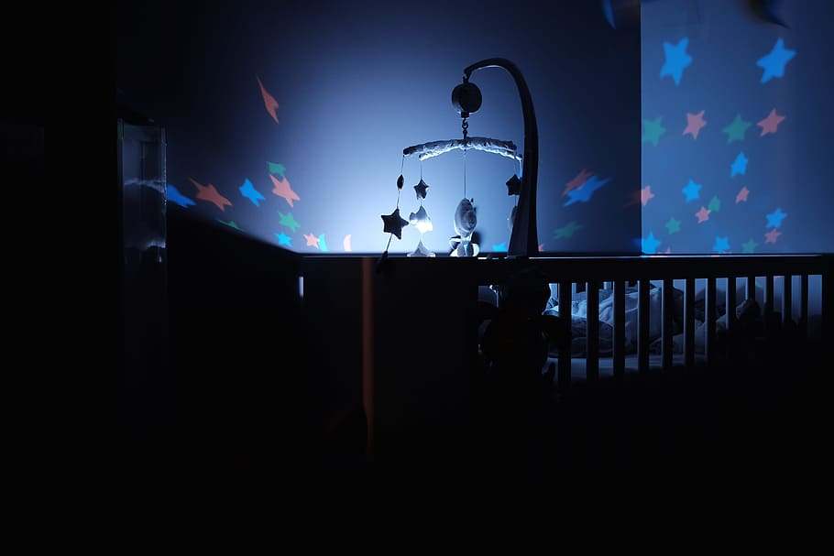

IOT-BASED
BABY CRADLE

Slide 2
CONTENT
01
INTRODUCTION
02
OBJECTIVES
03
SYSTEM OVERVIEW
04
THINGS REQUIRED
05
SKETCH
06
WORKING/ APPLICATION
07
TIMETABLE
08
CONCLUSION

Slide 3
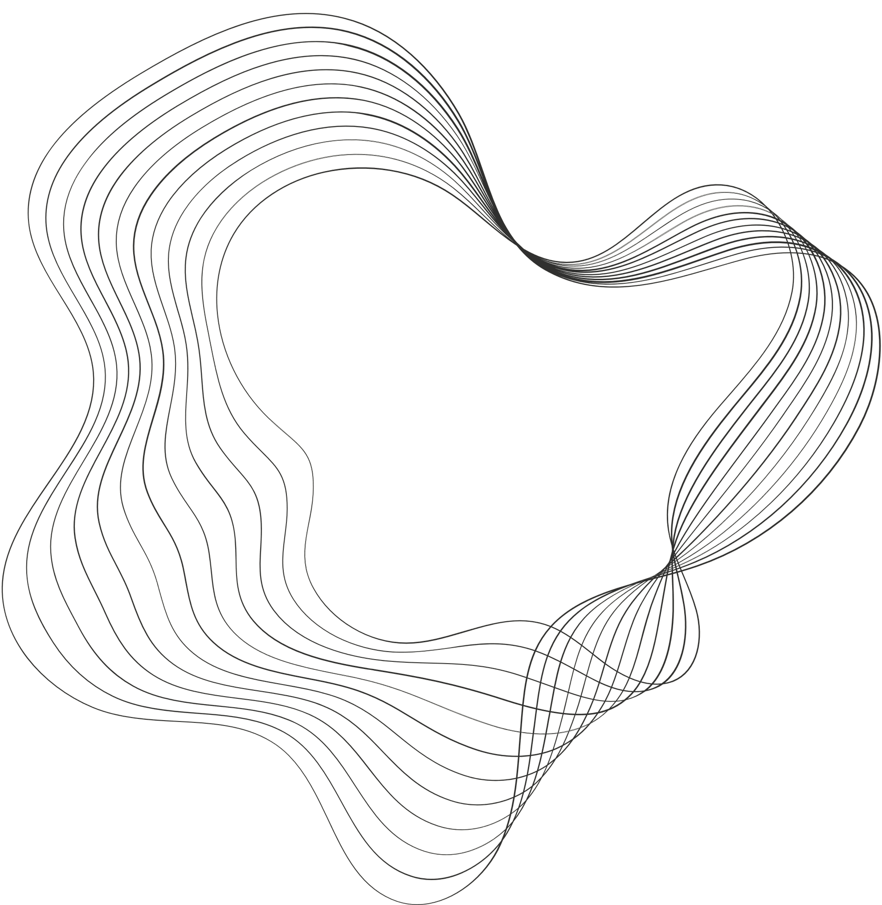
INTRODUCTION
Parents in todays world are busy in their professional life and for mothers, women they also have lots of work to do at home. So it may be expensive for having nanny. If they even they pay for nanny or baby caring centers. There is less assurance regarding health and how they treat the baby.
So far making the parents stress free or relax we are designing cradle system.

Slide 4






OBJECTIVES
Objective n° 1
Objective n° 2
Objective n° 3
Real-time Monitoring: Develop a system that uses sensors to monitor the baby's crying, wetness of bed, and movements in the cradle.
Automated Alerts and Actions: Enable the cradle to automatically respond by swinging, sending alerts to parents for wetness or temperature changes, ensuring timely care
IoT Connectivity and Safety Features: Implement IoT connectivity via GSM module for instant parent notifications and incorporate safety measures like motion detection for added security.

Slide 5
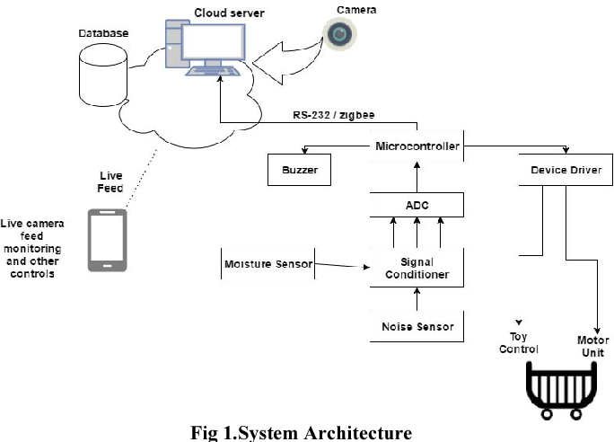
SYSTEM OVERVIEW

Slide 6

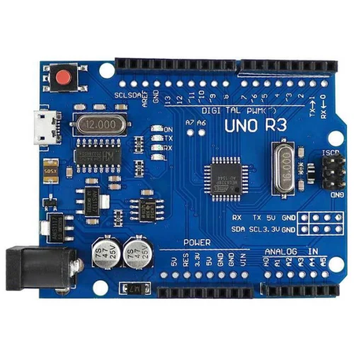
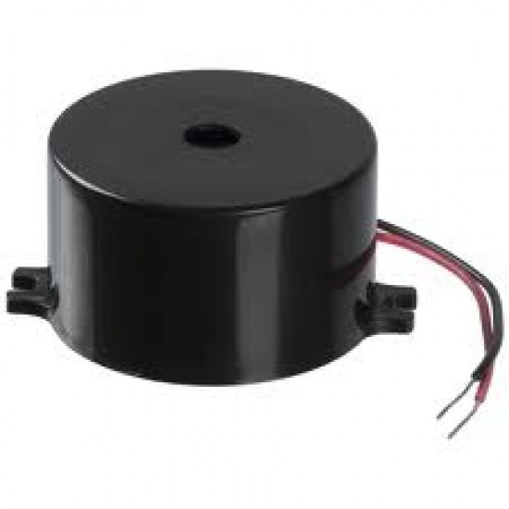
THINGS REQUIRED
Microcontroller : Arduino Uno
Sound Sensor : MIC sensor
SIM900A : Sim Module
Wet Detection Sensor : Moisture sensor
Baby Movement Sensor : PIR Sensor
Servo Motor
Power Source : 12V 2 amp Adaptor

Slide 7

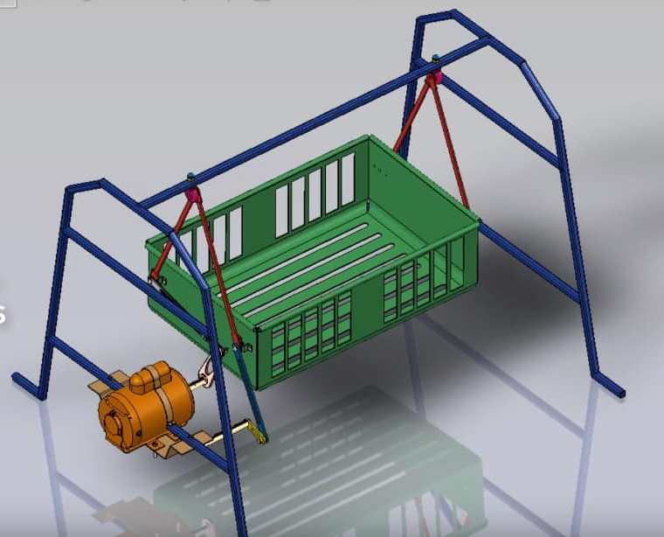
SKETCH

Slide 8
WORKING
Arduino is main heart of this project and it will read all sensors and control cradle swinging. When Baby cries then MIC sensor identify and gives signal to Arduino. Arduino send PWM pulses to servo motor to swing cradle. MEMS sensors attached to baby to monitor moments of baby. When baby moves fan will be ON. If baby urinates then buzzer will be ON. Arduino reads all sensors data and displaying on LCD. Also, it sends sensors data to IOT cloud server through ESP8266. We can monitor baby conditions when baby is in cradle from remote server.
ADVANTAGES
Cost efficient
User friendly
Ensures safety
Minimal manual work
Baby sooth comfortably

Slide 9
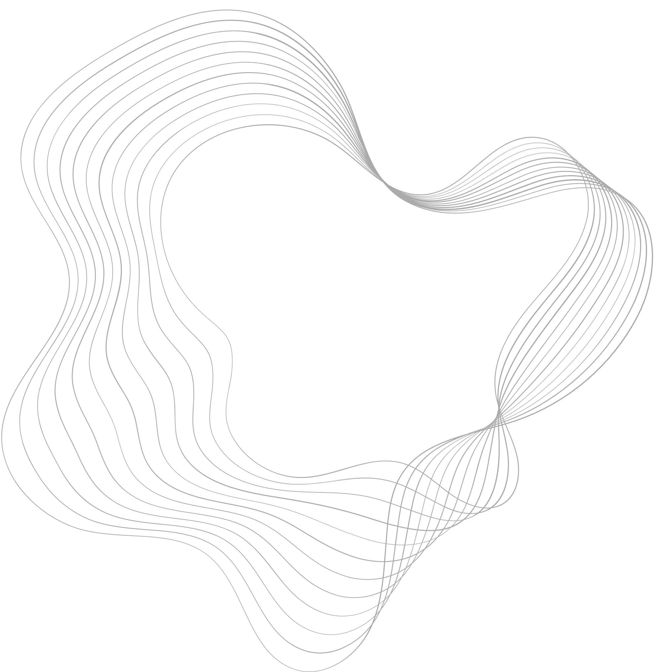
CONCLUSION
In health and Monitoring Point of view of the baby, it is possible to get continues updates of baby. System will be less expensive and user friendly will be built which will make reliable for parents for doing that work without worries.

Slide 10
THANK
YOU

